Slide 1
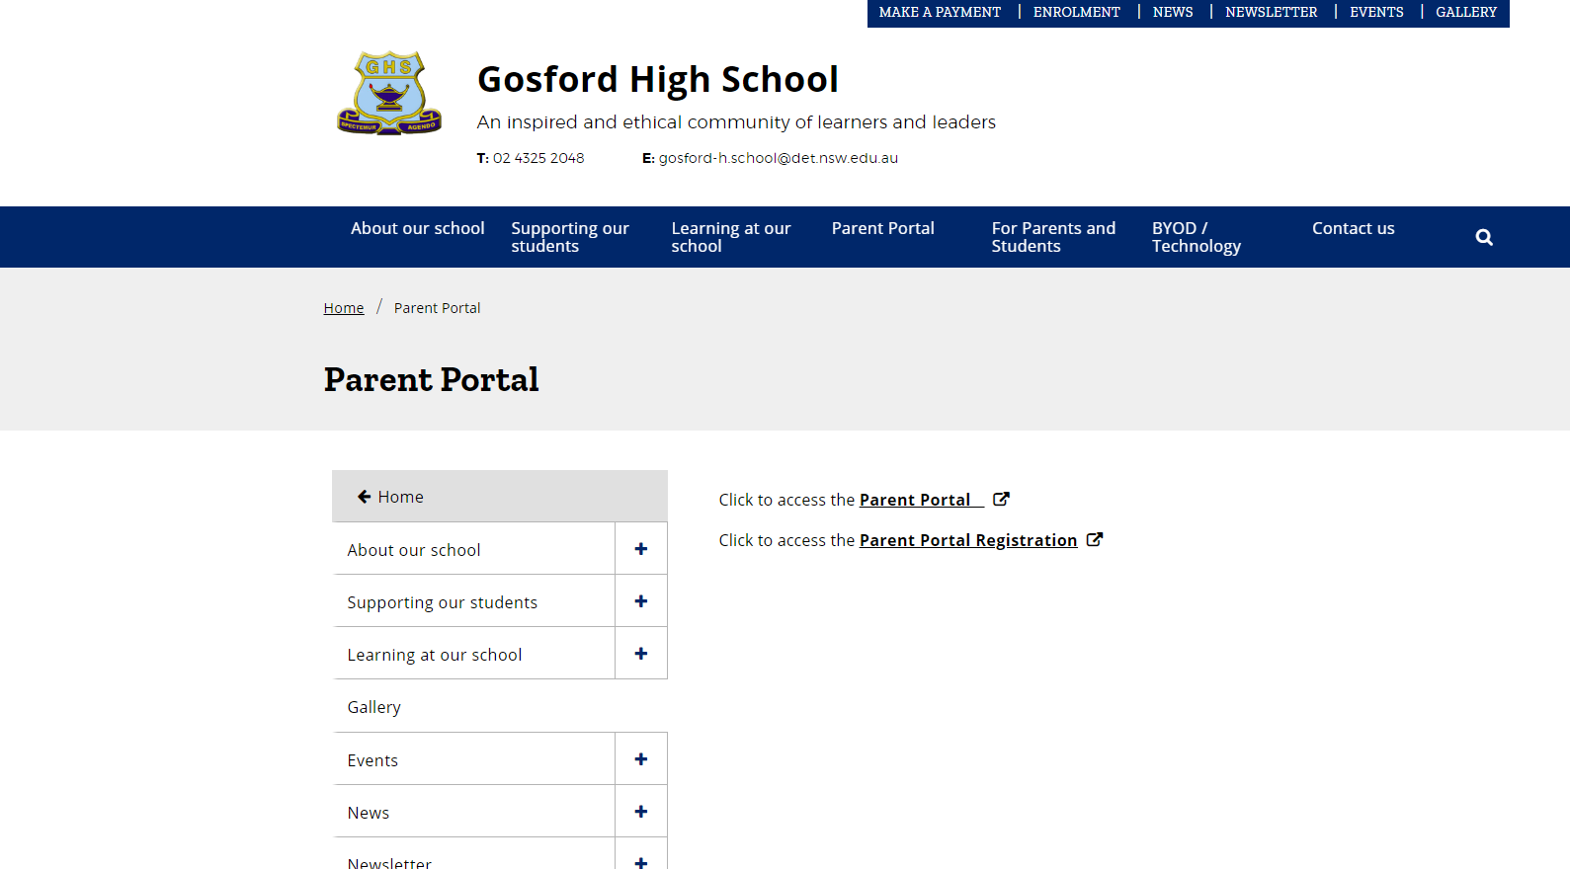
Access the parent portal via the website or the following URL

Slide 2
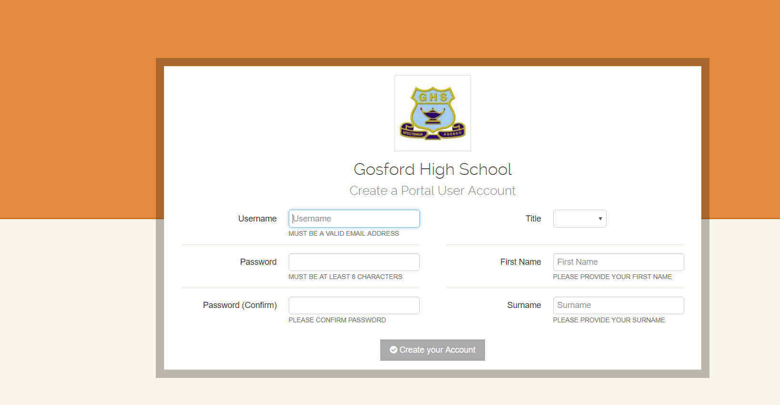
https://gosfordhs.sentral.com.au/portal/login/registration

Slide 3
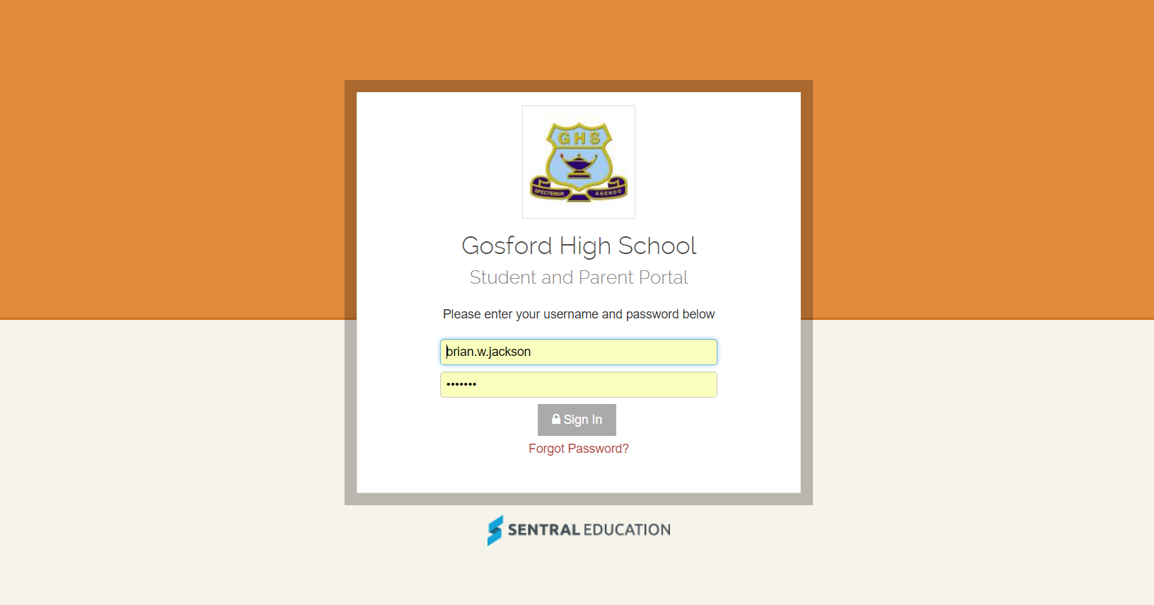
To log on

Slide 4
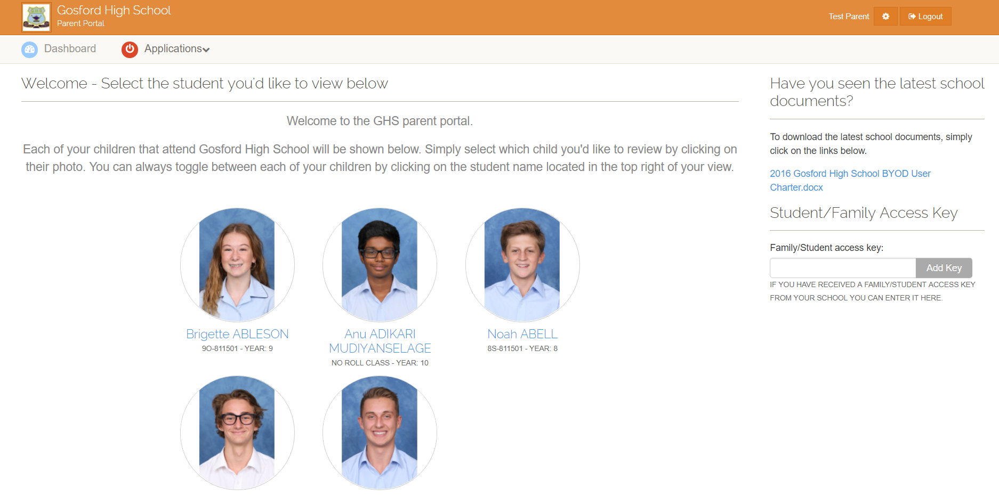
Once on the the site add the access key

Slide 5
